Slide 1

Welcome to:
Thursday, September 22nd, 2016
Broun Hall Room 235

Slide 2
Introduction
Founded in 2006 by the Auburn University ECE Department
Acts as a “makerspace” that provides a place for students to work collaboratively on projects.
Provides the space, tools, and some resources for these projects.
No prior experience is required.
Great for students of all ages and majors.
Can act as a pathway to get involved in Undergraduate Research.

Slide 3


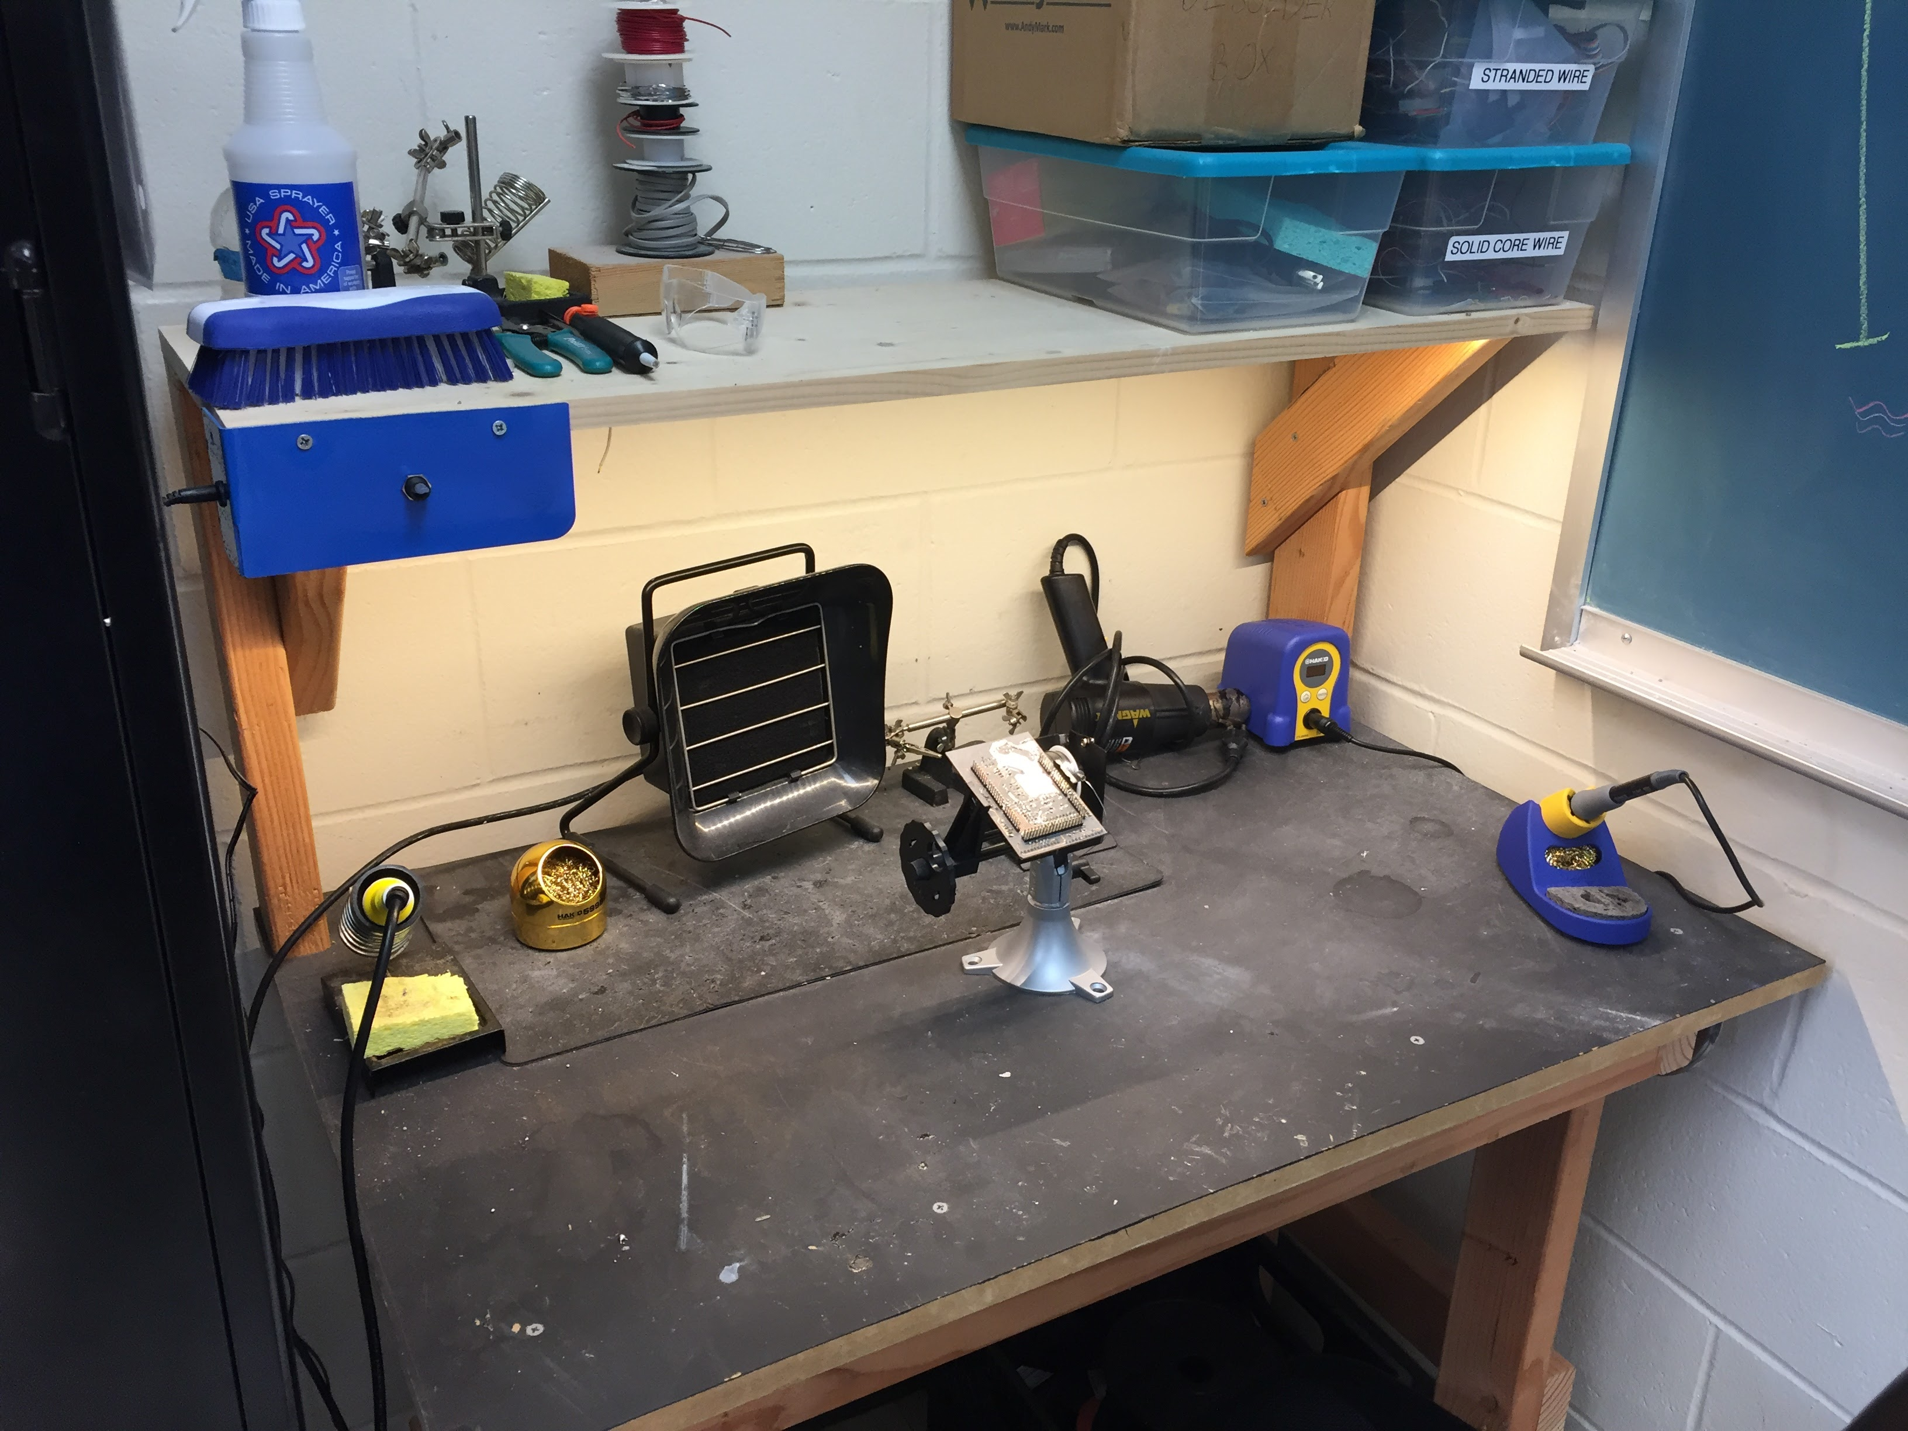
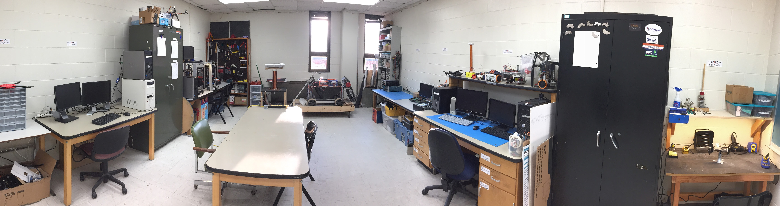
Our Lab
Broun Hall
Room: 367

Slide 4
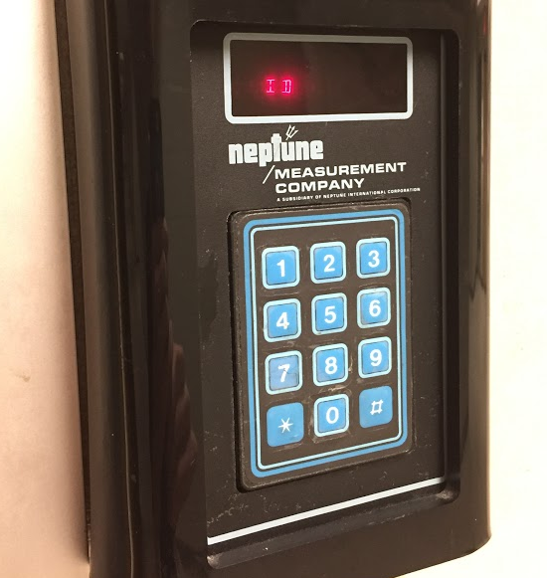
How to become a Member
Log 5 constructive hours in the lab
Write the times on the sheet on the cabinet on the left side of the room.
Contact our Secretary:
William Crubaugh
Email: wcc0023@auburn.edu
Then visit Autry May to get Code Access
Office: Broun Hall Room 252
Email: eceshop@auburn.edu
You will be given code access code that will give you 24/7 access to Broun 367 and Broun Hall.

Slide 5
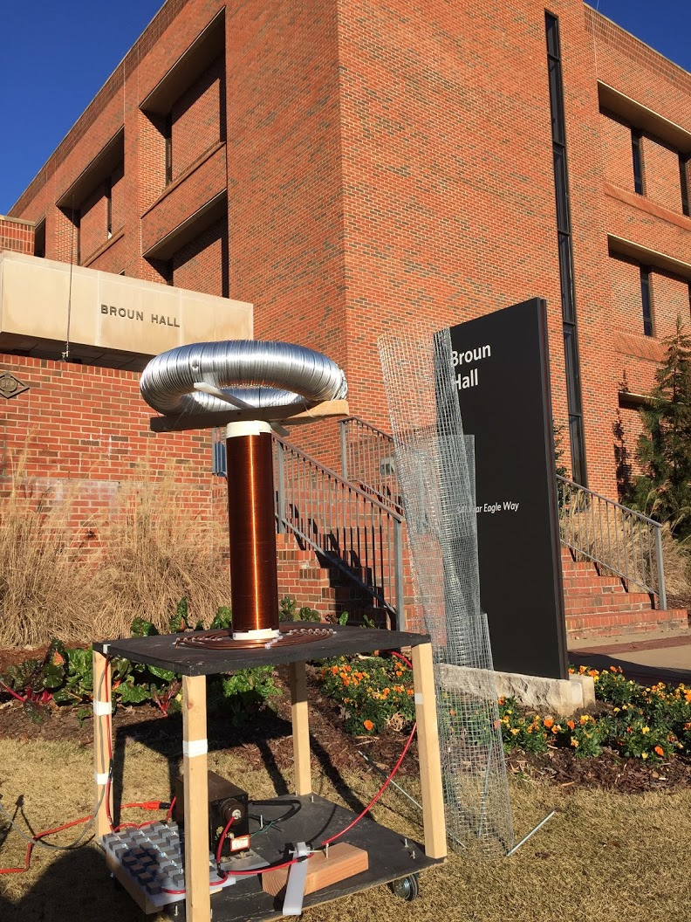
Outreach Events
Outreach Coordinator- Jack Thomas jet0024@auburn.edu
Engineering Parent Homecoming Tailgate
War Eagle BEST Robotics Competition
October 8th, 2016
https://docs.google.com/forms/d/e/1FAIpQLSfqpxiz0g8yq0XAby3W-UsmvRN2_1Ku0nfGDU5F-r-Vj3ZCHQ/viewform
Sanford Middle School in Opelika, AL STEM Event
Thursday October 20 and Friday October 21 8am-2:35pm
Free Breakfast and Lunch
SCORE Robotics Education Program- New program starting this semester
E-Day- Late February or early March
IEEE Sumo Robotics Competition (with local middle and high schools)- Spring 2017
E-Day 2016 Tesla Coil Demonstration

Slide 6
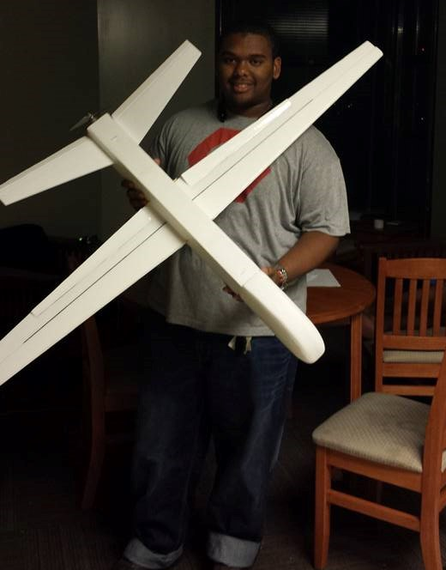
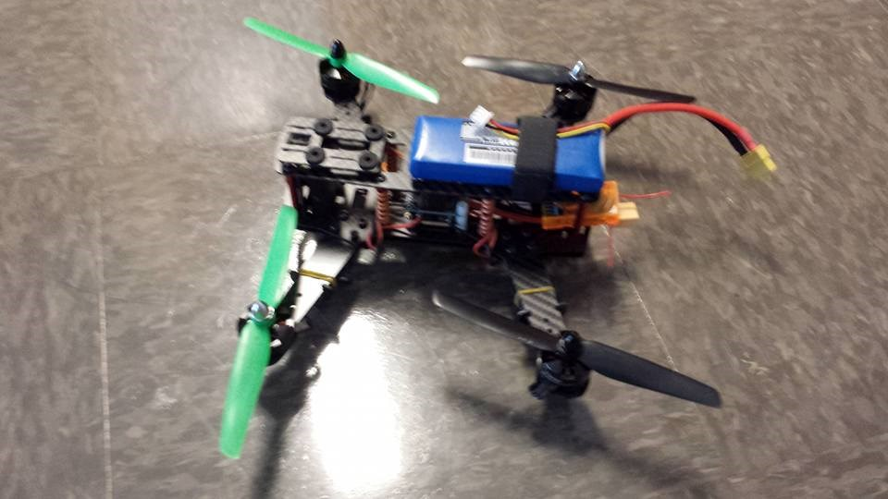
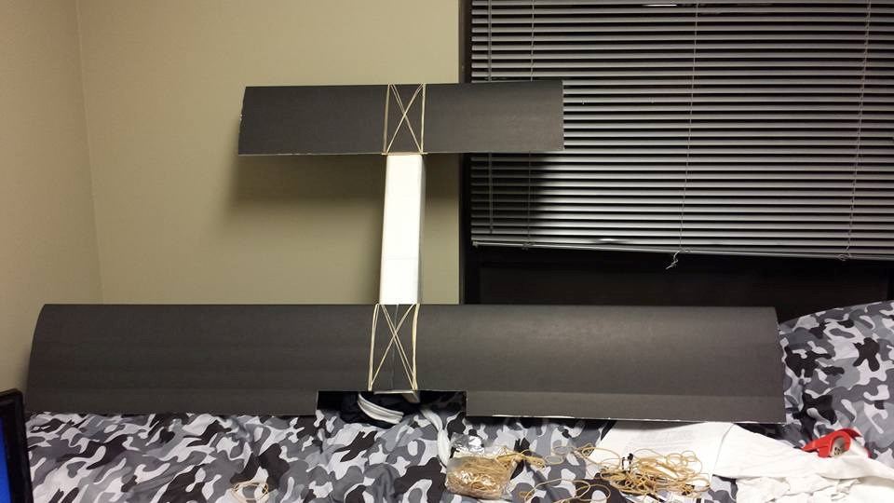
RC Hobbyist Club (RCHC)
Teaches 3D design, construction and control of RC airplanes, multi-copters, cars, and boats.
Designed to need no prior experience.
Functions very similar to SPARC
Meetings:
3-4 in Broun 235
Dues
$10 per semester
Club President
Joshua Parker jcp0048@auburn.edu

Slide 7
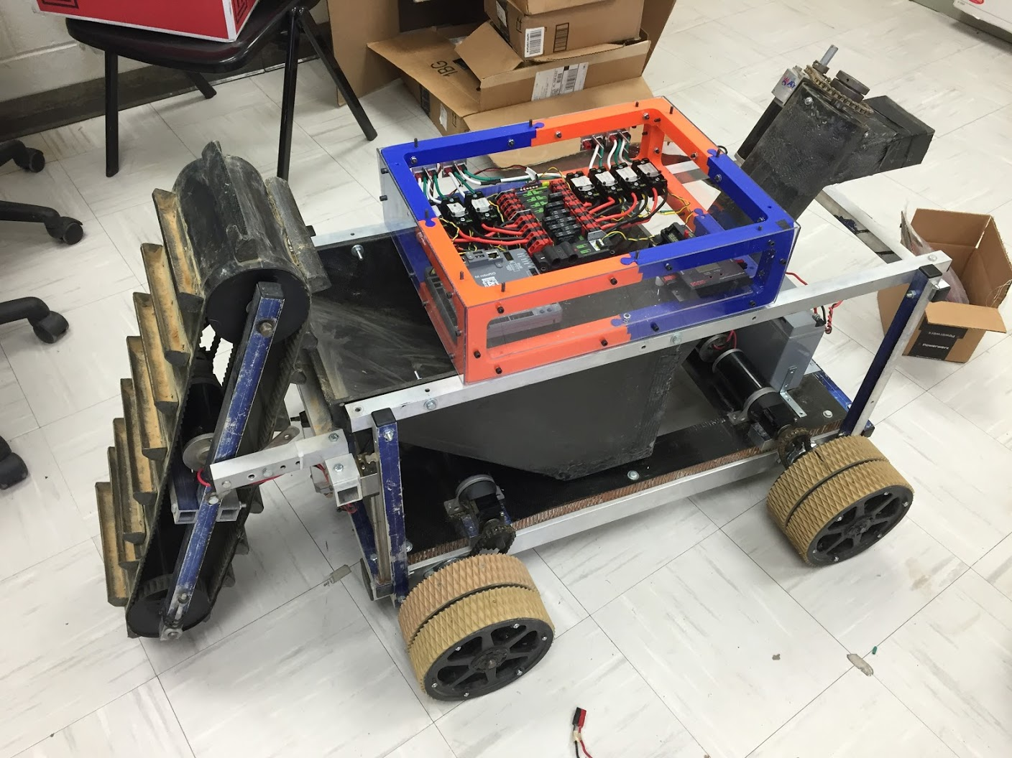
Projects: NASA Robotics Mining Competition
A 3rd Year Robotics team that designs and builds a robot
collects simulated Martian soil in a small arena
dispenses it into a small bin on the other side of the arena.
Can be remotely controlled or for bonus points autonomously controlled
Competition is held at the Kennedy Space Center this year from May 22nd-26th, 2017
Part of Auburn’s SPACE Club and affiliated with SPARC.
Team Lead:
Jeremy Frasher jjf0010@auburn.edu
Meetings:
Mondays 6:15 PM
2016 NASA RMC Robot

Slide 8
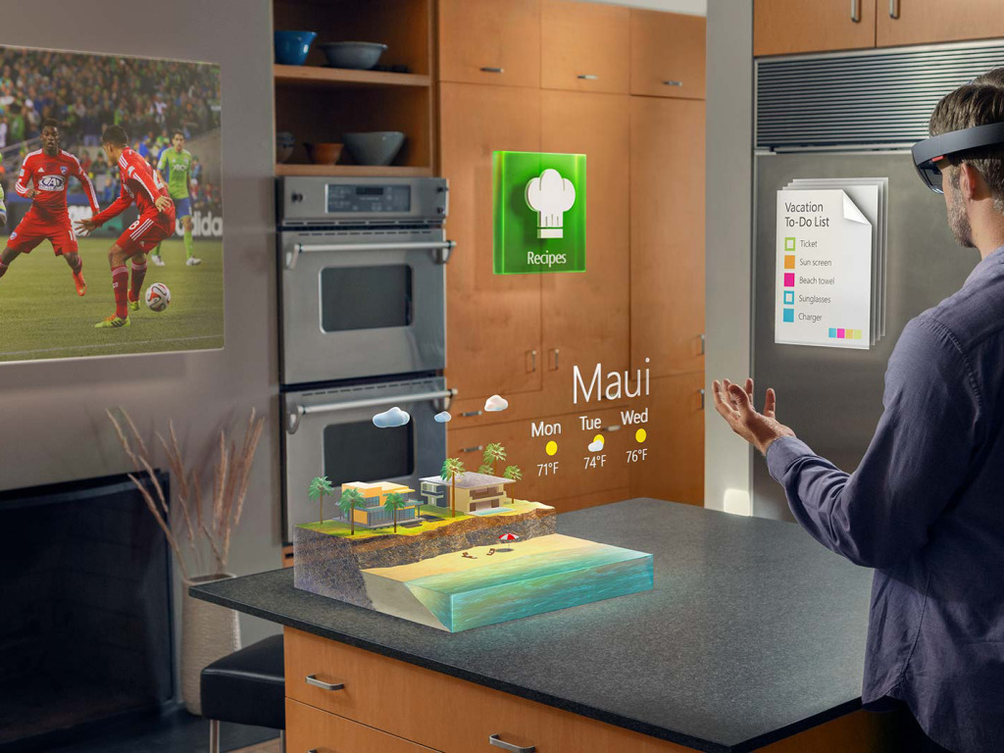
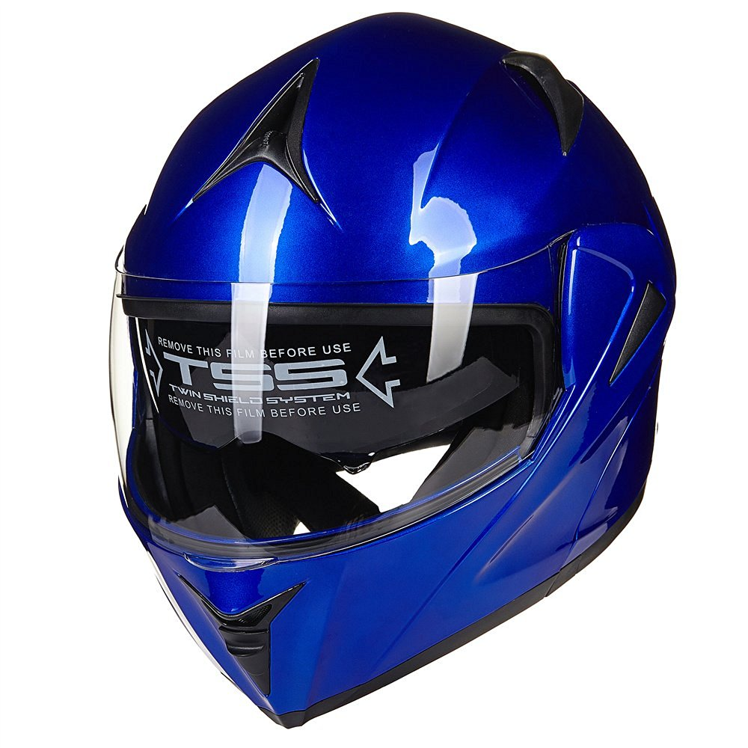
Projects: Augmented Reality Helmet
Create a augmented reality helmet.
Possibly using dual projector or reflected LCD’s
Similar to Microsoft Holo Lens
Possible Users of this Technology
Motorcyclists
Race Car Drivers
Astronauts
Soldiers
Fighter Pilots
Proposed Capabilities
Rear view
GPS directions
Music abilities
Team Lead:
Noah Niedzwiecki nmn0005@auburn.edu
Meetings:
Wednesday 5pm-6pm
Rendering of Microsoft Hololens
Possible Helmet

Slide 9
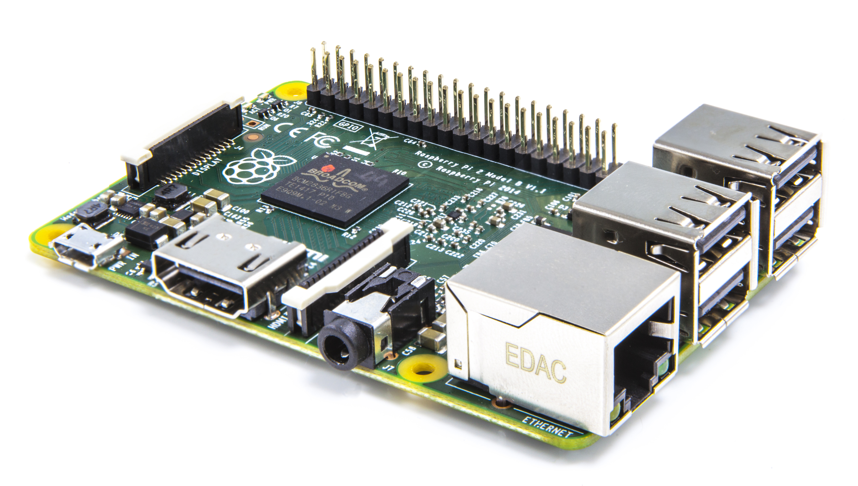

Projects: Automated Lab
Create an automated lab assistant.
Will be voiced controlled.
Will allow door to be unlocked temporarily remotely to allow new members access to the lab.
Great project for new members.
Team Lead:
Josh Jablonowski jdj0019@auburn.edu
Meetings:
Wednesdays 6:00pm-7:00pm
Location- SPARC Lab Broun 367
Raspberry Pi
Arduino Uno

Slide 10
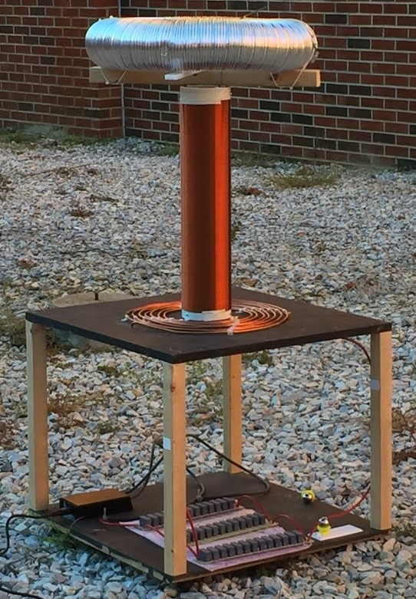
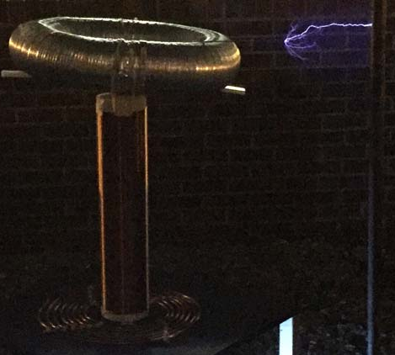
Projects: Tesla Coil
Last year we created a spark gap Tesla Coil.
It generated 400,000 volts of electricity
Goals this year:
Enhance it using homemade capacitors
Make it musical
Team Lead:
Matthew Castleberry mtc0030@auburn.edu
Meetings:
Not set

Slide 11
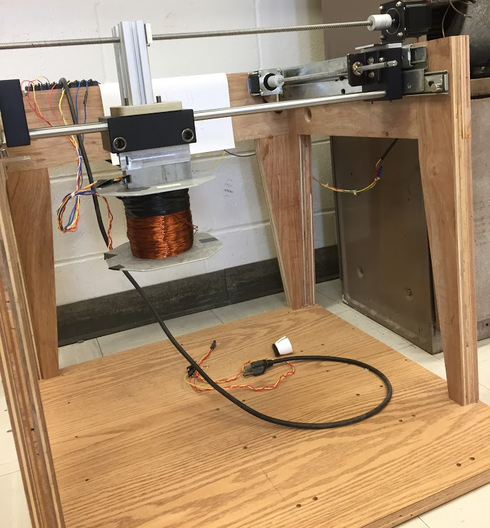
Projects: MAGLEV
Originally a senior design project involving magnetic levitation of small metal objects.
Uses 2 dimensional axes to move an electromagnet.
By varying frequency in coil, it can “sing” War Eagle
Also will be used for SCORE Crane Machine
Team Lead:
Shane Williams smw0031@auburn.edu
Meetings:
Not set

Slide 12
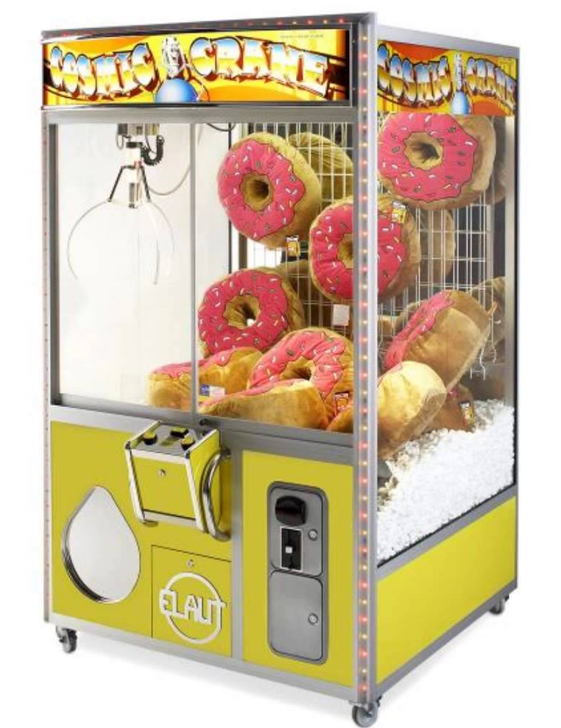
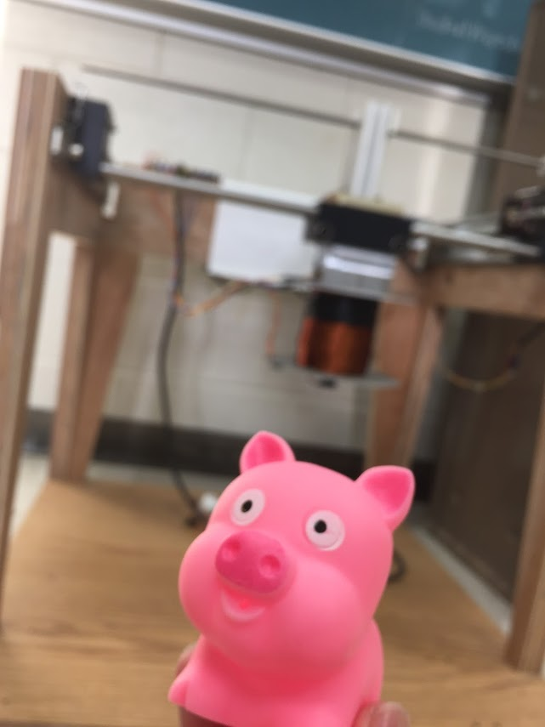
Projects: SCORE Crane Machine
Build a claw machine where “everyone wins”.
Will provide a fun way to distribute promotional items for the Southeastern Center of Robotics Education (SCORE).
Suspend a clawbot vertically, so people could use a joystick to manipulate it and pick up pens, squishy balls, etc. with the SCORE logo.
Team Facilitators:
Matthew Castleberry mtc0030@auburn.edu
Shane Williams smw0031@auburn.edu
Meetings:
Not Set

Slide 13
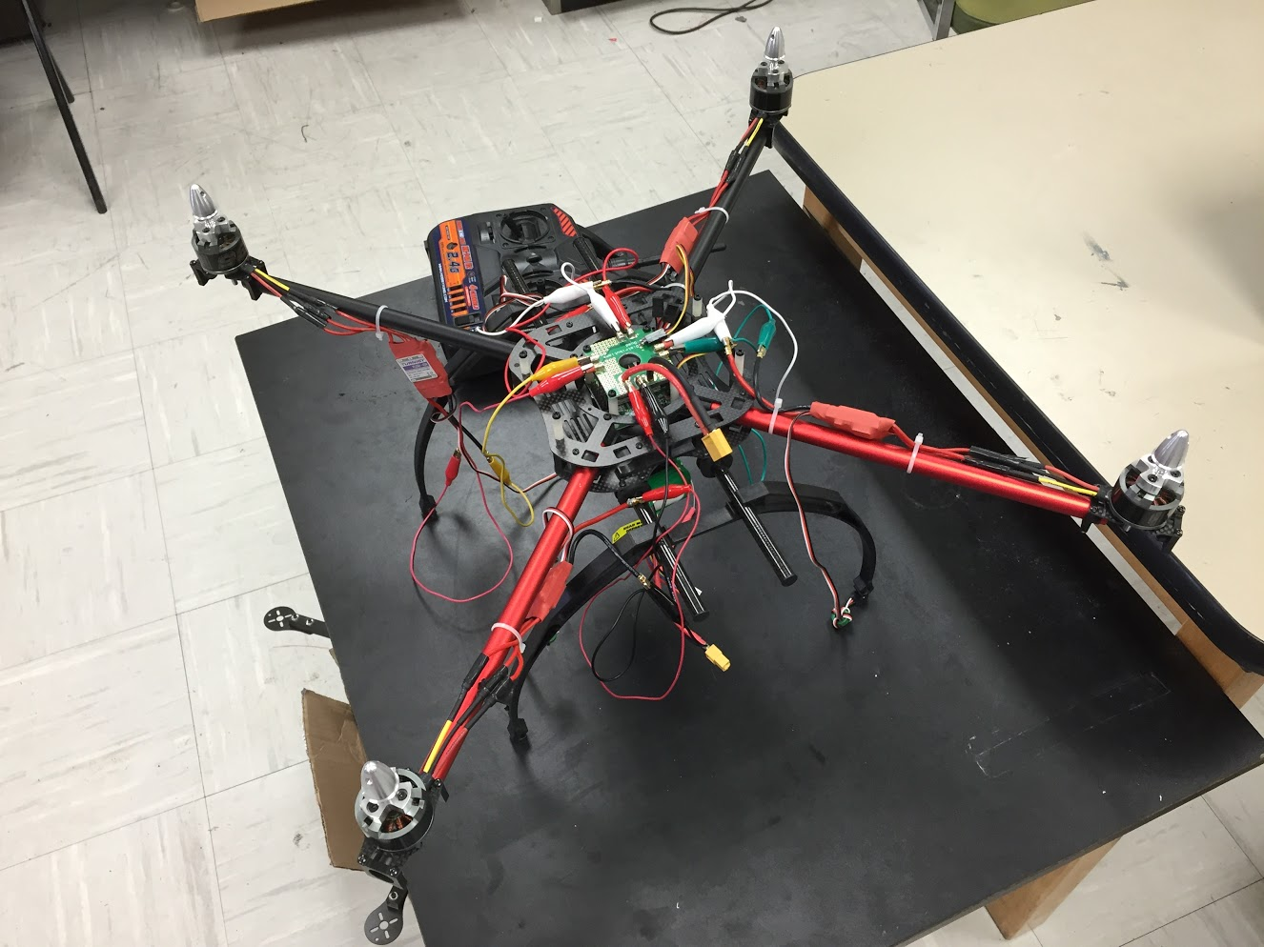
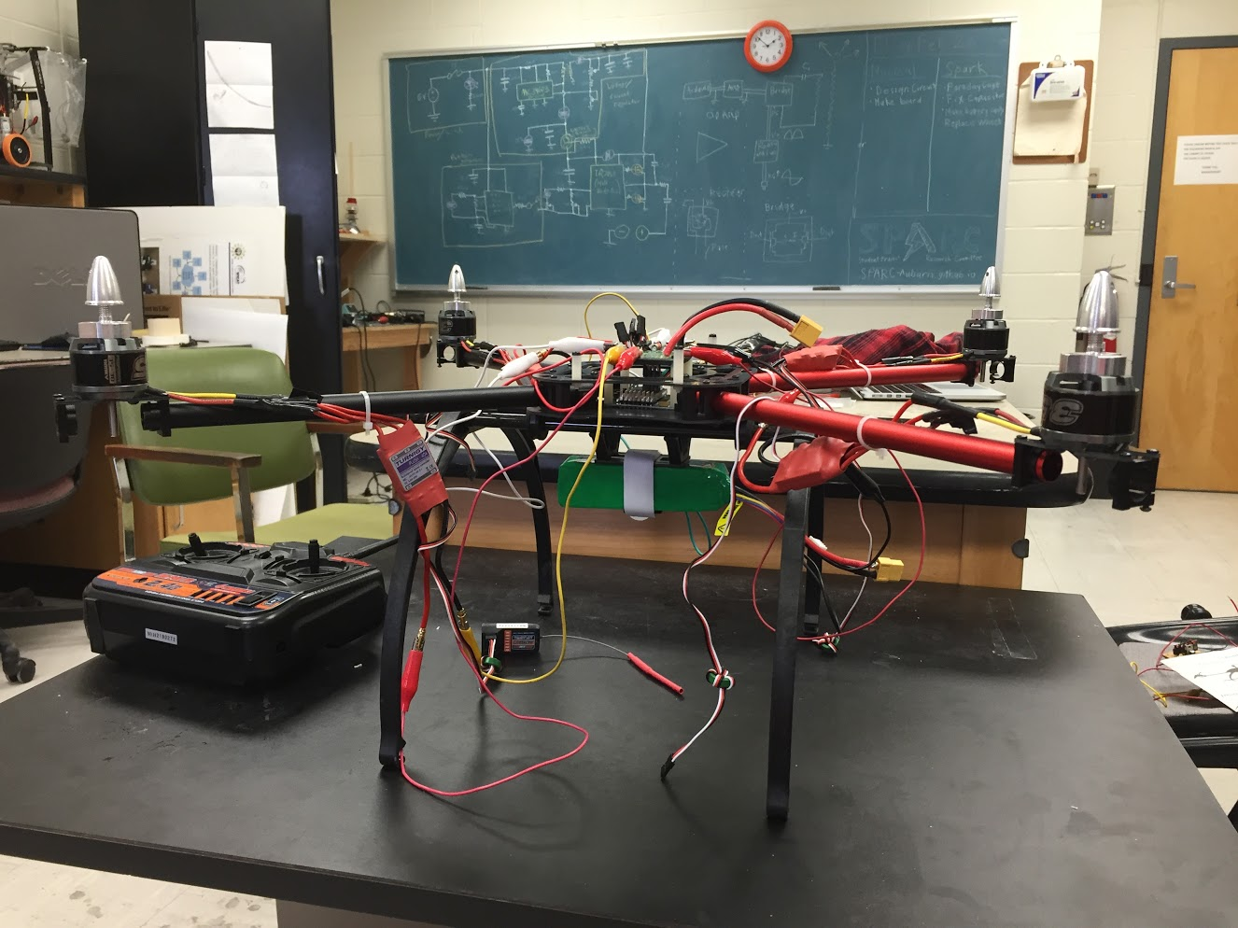
Projects: Quadcopter
A personal project by Josh.
3 years in the making
Joint project between SPARC and RC Hobbyist Club
Goals:
Solve an issue with one of the speed controllers and motors to enable the quadcopter to fly.
Possibly put an Arduino or Raspberry Pi on board for autonomous or semi-autonomous flight.
Team Lead:
Josh Jablonowski jdj0019@auburn.edu
Meetings:
Not set

Slide 14
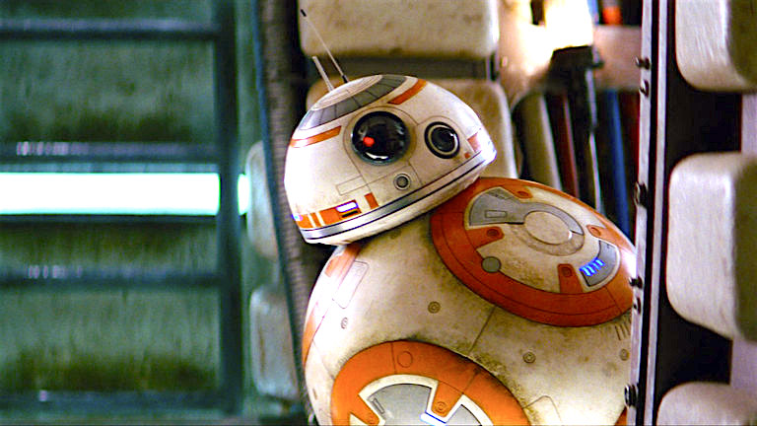
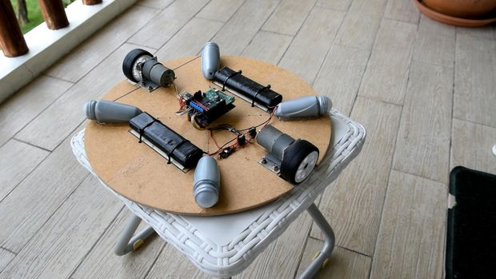
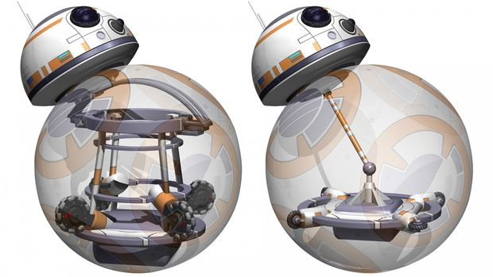
Projects: BB-8 robot
Build a robot that uses an internal mechanism to manipulate a ball to move around.
Also has semispherical “head” with sensors to detect surroundings.
A great E-Day project.
Based off of Instructables tutorial: http://www.instructables.com/id/DIY-Life-Size-Phone-Controlled-BB8-Droid/
Team Lead:
Not set
Meetings:
Not set

Slide 15

Review of Current Projects
Active
NASA RMC
Augmented Reality Helmet
Automated Lab
Quadcopter
SCORE Crane Machine
Proposed
MAGLEV
Telsa Coil
BB-8 robot
Denotes that the project has an active GroupMe

Slide 16
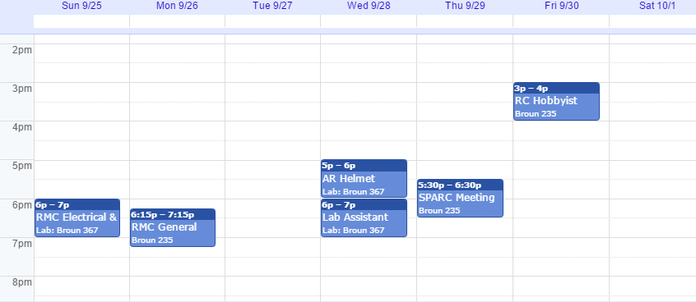
Meetings Schedule: Week of 10/2

Slide 17
Project Proposal Form
*Project Title: ____________________
*Project Description: ______________
____________________________________
Proposal Date: __/__/__
Expected Finish Date: __/__/__
*Funding Needed (Yes/No): __________
Proposed Budget: ___________________
*Project Lead: _____________________
Other Members: _____________________
For completion by an officer and the advisor:
Officer Name: _______________ Date: __/__/__
Advisor Name: _______________ Date: __/__/__
Can be found on the Github:
https://github.com/SPARC-Auburn/Documents/blob/master/Forms/Project%20Proposal%20Form.txt

Slide 18




Project Item Order Form
Project Title: ________________
Form Submission Date: __/__/___
Item Name: ____________________
Vendor: _______________
Link: _________________
Part #: _______________
Amount: _______________
Price Per Each: $______
Price Total: $_________
…
Total Cost (no shipping or taxes):
$________
Can be found on the Github:
https://github.com/SPARC-Auburn/Documents/blob/master/Forms/Project%20Item%20Order%20Form.txt

Slide 19
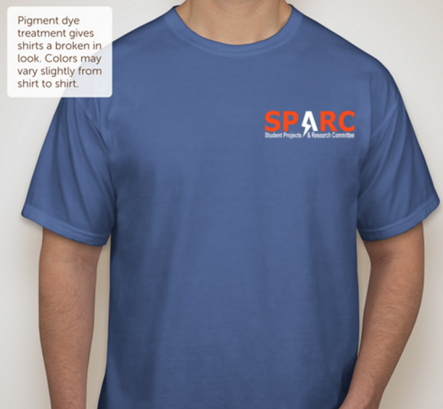

SPARC T-Shirts: Possible Design
Source: CustomInk.com

Slide 20

SPARC T-Shirts: Back Graphic

Slide 21
Maker Training Sessions
Thursday, September 29th- Raspberry Pi/Linux
Thursday, October 6th- Solidworks/3D Design
Thursday, October 13th - No Meeting for Fall Break
Thursday, October 20th- TAZ LulzBot/3D Printing
Thursday, October 27th- Github/Version Control Software
Thursday, November 3rd- Robotics/Control Systems(?)
Thursday, November 10th – Printed Circuit Board Design(?)
*meeting topics may be subject to change as needed

Slide 22
What is a Raspberry Pi?
A Raspberry Pi is a relatively inexpensive single board computer.
Only $5 for Zero or $35 for more powerful one
Capable of running operating systems such as Raspbian Linux, Debian Linux, Windows 10 IOT, etc.
Originally released in February 2012.
Has USB ports, video outputs, and an audio output.
Is capable of connecting to the internet through WiFi or Ethernet.
Has General Purpose Input and Output Pins (GPIO) to control electronic circuits.

Slide 23
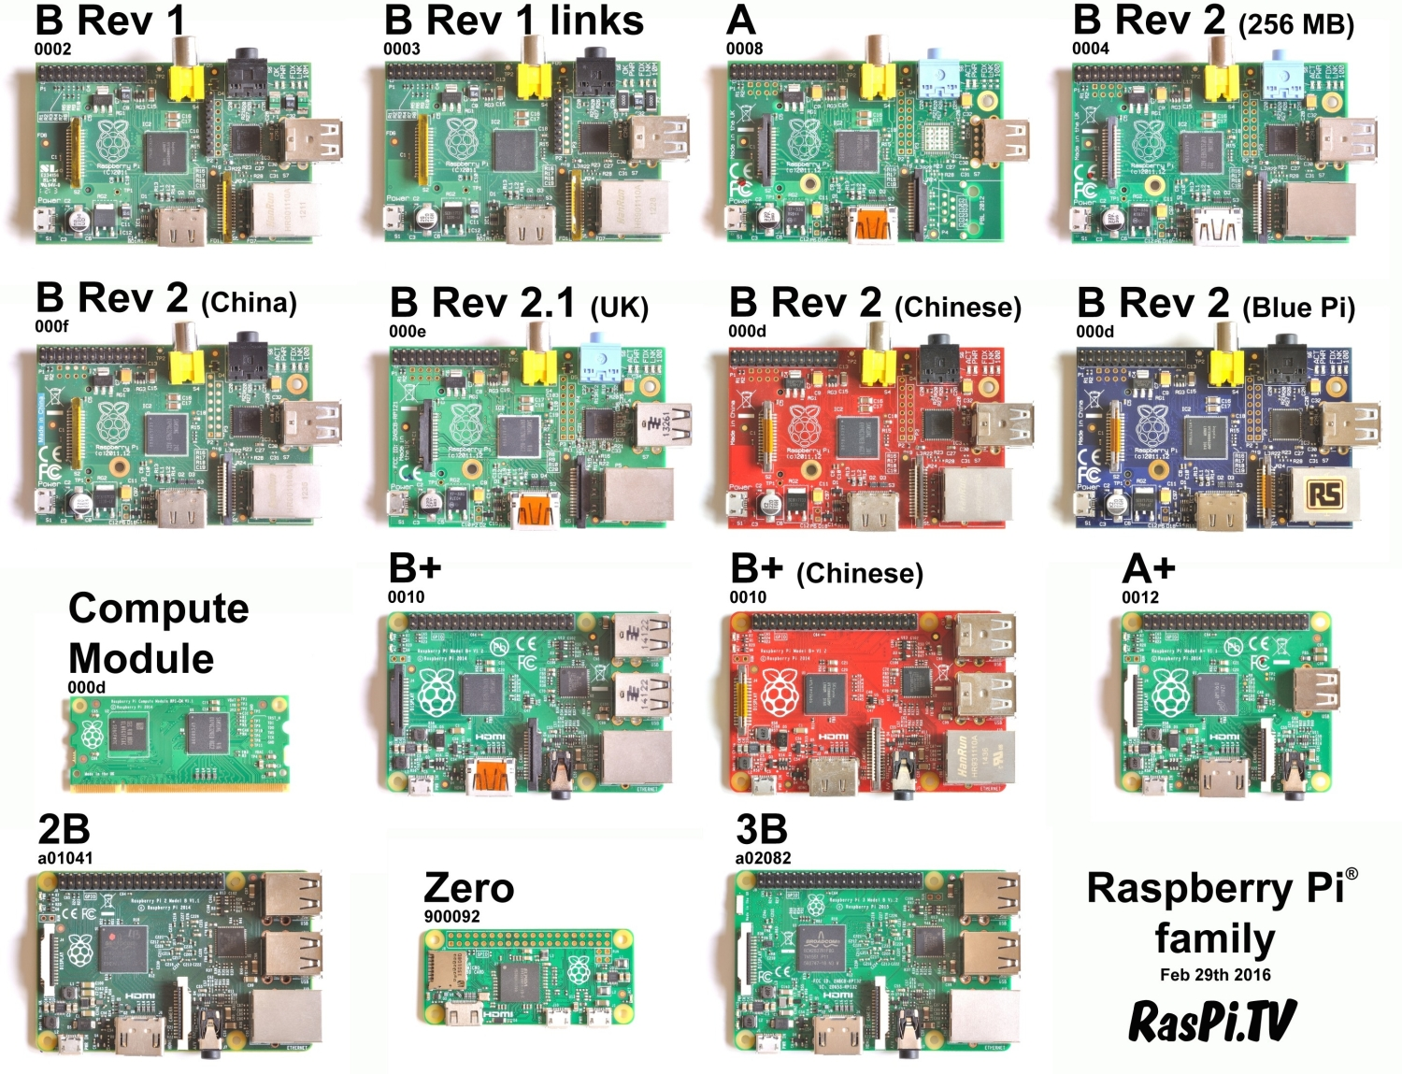
Different Versions of the Pi

Slide 24
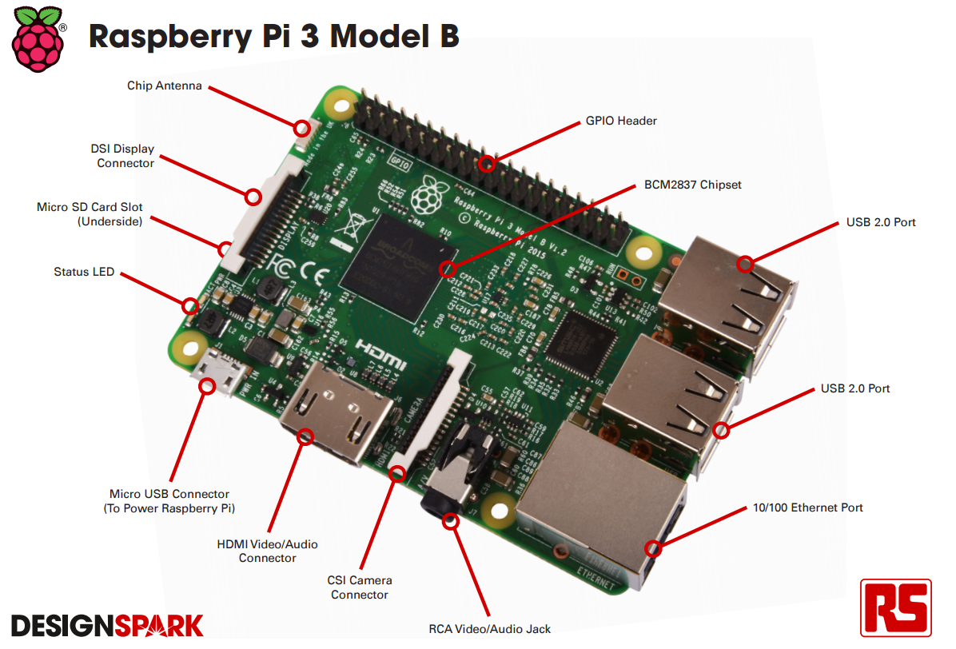

Slide 25
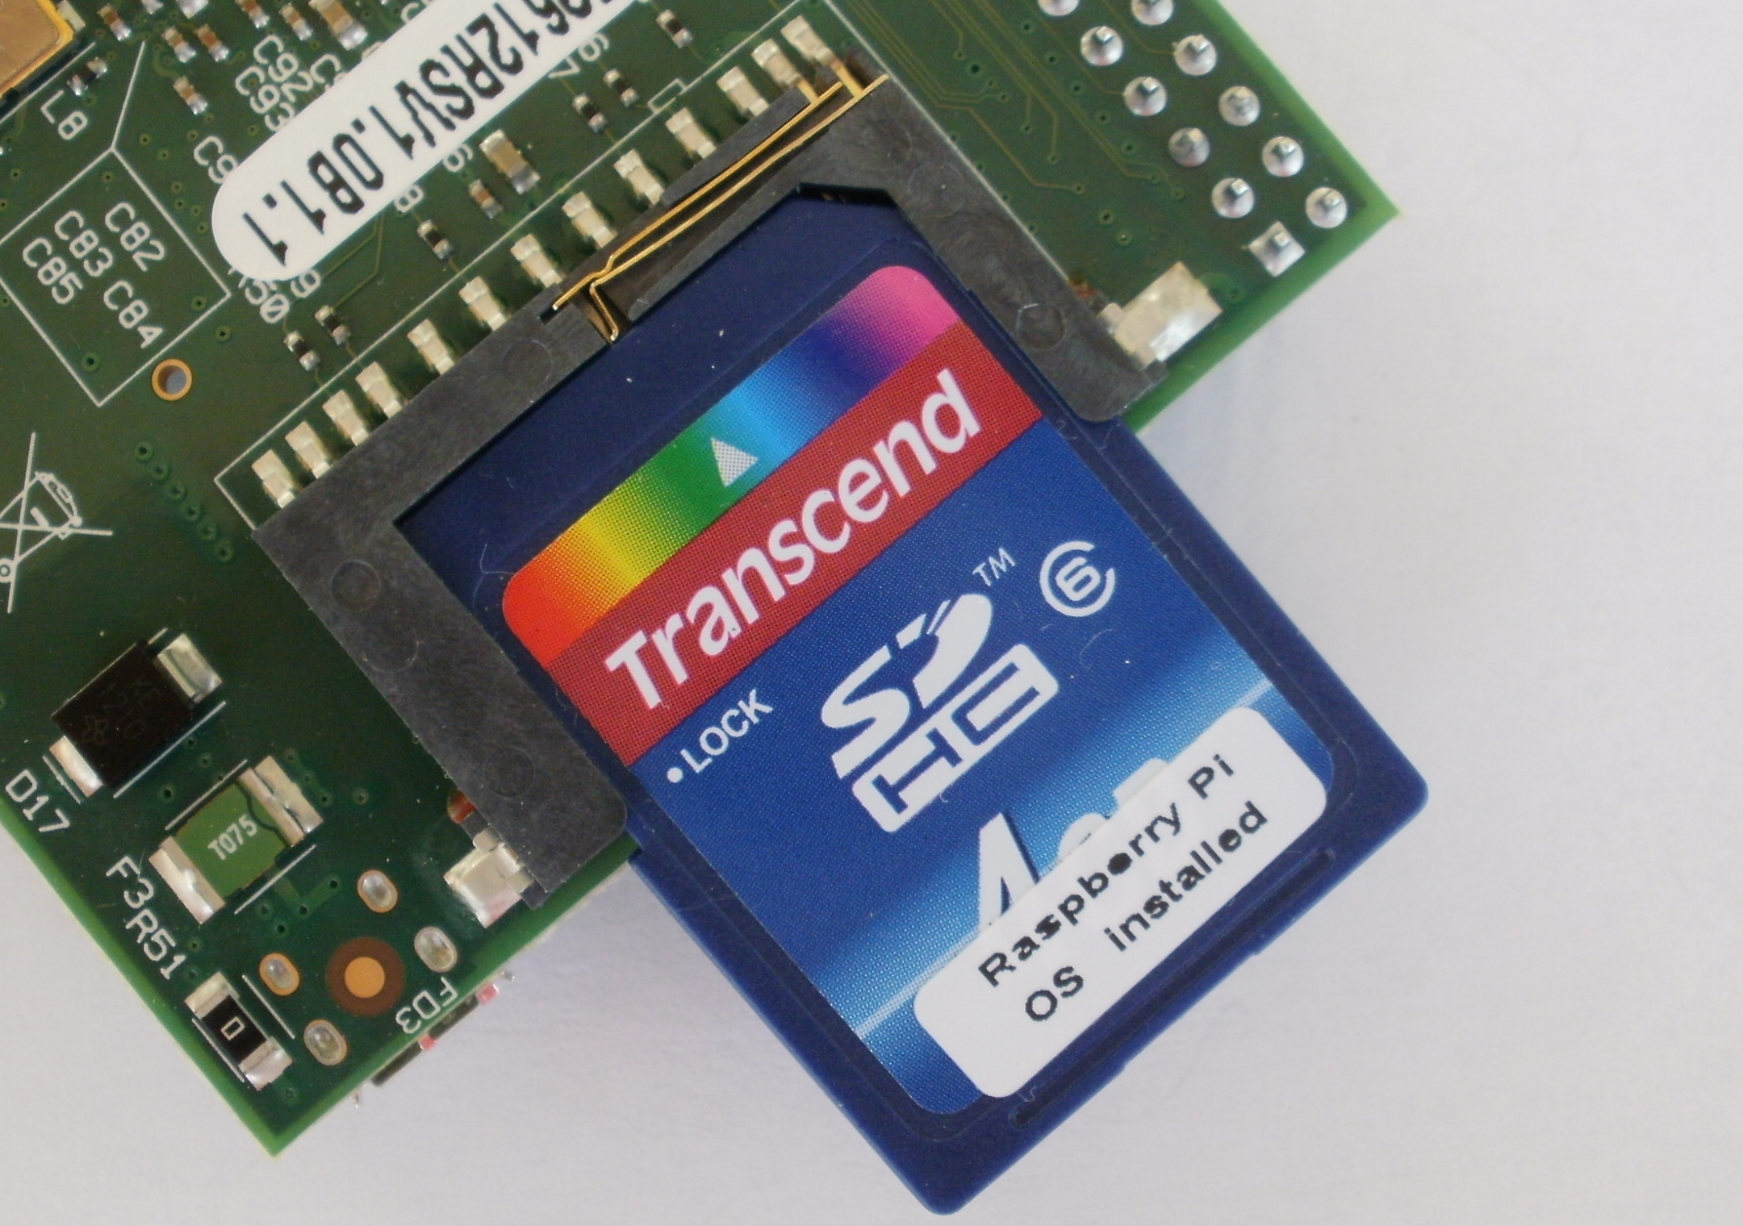

Setting up the Pi SD Card
The Pi main storage is on an SD card 4GB or greater.
Raspbian Linux is most highly supported operating system.
Download Raspbian or NOOBS from Raspberry Pi website.
https://www.raspberrypi.org/downloads/raspbian/
Follow the installation guide.
Will require you to download an SD image writer.
If display does not work a setting may need adjusted in .config file.

Slide 26

What is Linux?
Linux is an open source operating system.
It is used in many products and servers.
Allows full customization.
Great for software development.
Hundreds of free distros.
Most have a Graphics User Interface (GUI).
Use the terminal for full customization.

Slide 27
Additional Notes
Boot up by applying power using Micro USB.
Make change to .config file if no display.
Username is “pi”
Password is “raspberry” by default.
Open up terminal.
Type in commands.

Slide 28
Network and Python Commands
Network:
Download files- wget https://www.example.com/
Check connection- ping -c 4 google.com
Ultimate network utility- ifconfig
Python:
For installation if not installed- sudo apt-get install python3
To create new file- nano filename.py
To run file- sudo python filename.py

Slide 29
Using GPIO with Python
#imports
import RPi.GPIO as GPIO
Import time
GPIO.setmode(GPIO.BCM) #sets pin numbers
GPIO.setup(11, GPIO.OUT) #sets pin 11 to output
for i in range(0,50): #start loop
GPIO.output(pin,GPIO.HIGH) #turn LED on
time.sleep(1) #wait one second
GPIO.output(pin,GPIO.LOW) #turn LED off
time.sleep(1) #wait one second
GPIO.cleanup() #reset GPIO

Slide 30
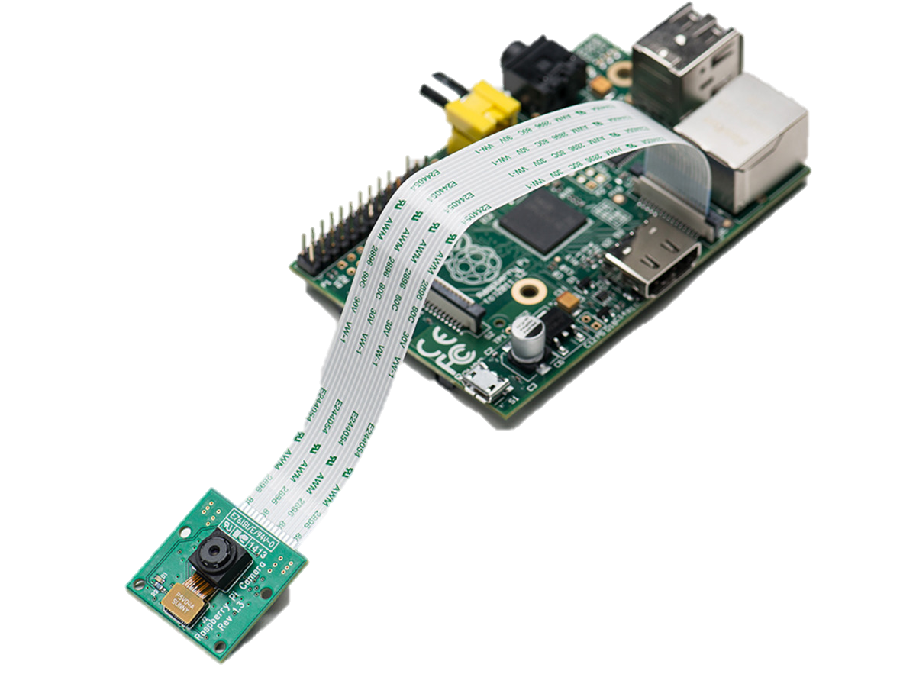
Using the Pi Camera
https://www.raspberrypi.org/learning/getting-started-with-picamera/worksheet/
Plug in Camera
Press Menu>Preference>Raspberry Pi Configuration>Interaces
Make sure Camera is enabled

Slide 31
Using the Camera with Python
from picamera import PiCamera
from time import sleep
camera = PiCamera()
camera.rotation=0
camera.start_preview()
sleep(10)
camera.stop_preview()
camera.capture('/home/pi/Desktop/image.jpg')
camera.start_preview() camera.start_recording('/home/pi/video.h264') sleep(10) camera.stop_recording() camera.stop_preview()

